Slide 1
Discrete Mathematics
Chapter 9
Section 9.4-9.7
Graphs

Slide 2
Path, Walk, Trail
A path is a sequence of edges that begins at a vertex of a graph and travels from vertex to vertex along edges of the graph. It does not contain same vertex or edge more than once.
{v₁, v₂}, {v₂, v₃}, {v₃, v₄}, {v₄, v₅}, {v₅, v₆} is a path.
v₁
v₄
v₂
v₃
v₅
v₇
v₆

Slide 3
Path, Walk, Trail
A walk is a sequence of vertices and edges of a graph i.e. if we traverse a graph then we get a walk.
v₁, {v₁, v₂}, v₂, {v₂, v₃}, v₃, {v₃, v₄}, v₄, {v₄, v₅}, v₅, {v₅, v₆}, v₆, {v₆, v₃}, v₃, {v₂, v₃}, v₂, {v₂, v₇}, v₇, {v₇, v₁}, v₁ is a walk.
v₁
v₄
v₂
v₃
v₅
v₇
v₆

Slide 4
Path, Walk, Trail
A trail is used to denote a walk that has no repeated edge.
v₁, {v₁, v₂}, v₂, {v₂, v₃}, v₃, {v₃, v₂}, v₂, {v₂, v₇}, v₇, {v₇, v₁}, v₁ is a trail.
v₁
v₂
v₃
v₇

Slide 5
Connectedness in Digraph
Strongly Connected: A directed graph is strongly connected if there is a path from a to b and from b to a whenever a and b are vertices of the graph.
Weakly Connected: A directed graph is weakly connected if there is a path between every two vertices in the underlying undirected graph.

Slide 6
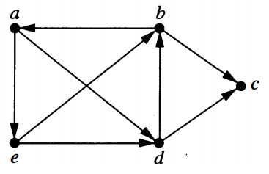
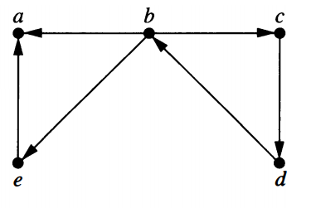
Exercise
Determine whether each of the following graphs is strongly connected or weakly connected.

Slide 7
Counting Paths Between Vertices
The number of paths between two vertices in a graph can be determined using its adjacency matrix.
Let G be a graph with adjacency matrix A with respect to the ordering v₁, v₂, …, v_{n}. The number of different paths of length r from v_{i} to v_{j}, where r is a positive integer, equals to the (i, j)th entry of A^{r}.

Slide 8
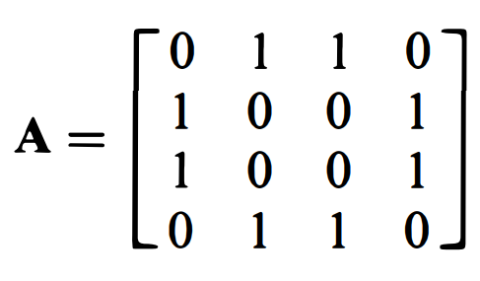
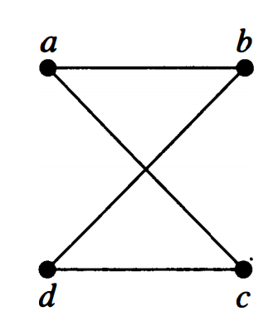
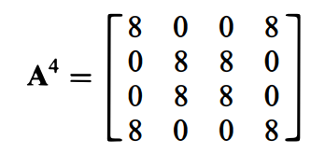
Example
How many paths of length four are there from a to d in the simple graph G?
The number of paths of length four from a to d is the (1, 4)th entry of A⁴

Slide 9
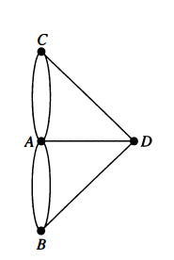
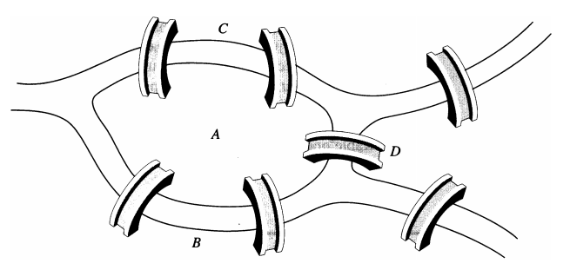
Euler Path
An Euler path in G is a simple path containing every edge of G.

Slide 10
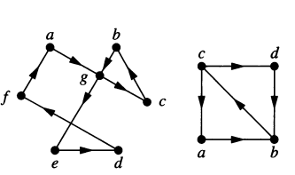
Exercise
Which of the directed graph have an Euler circuit?

Slide 11
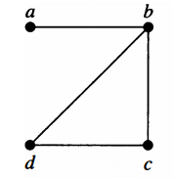
Hamilton Path
A simple path in a graph G that passes through every vertex exactly once is called Hamilton path.
The Hamilton path is a, b, c, d. But there is no Hamilton circuit.

Slide 12
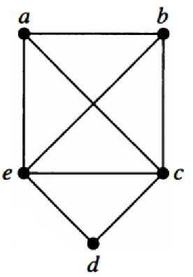
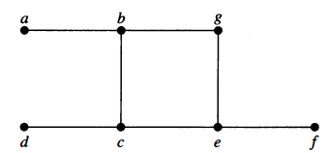
Exercise
Which of the simple graphs have a Hamilton circuit?

Slide 13
Example 7
Show that K_{n} has a Hamilton circuit whenever n ≥ 3
Solution: We can form a Hamilton circuit in K_{n} beginning at any vertex. Such a circuit can be built by visiting vertices in any order we choose, as long as the path begins and ends at the same vertex and visits each other vertex exactly once. This is possible because there are edges in K_{n} in between any two vertices.

Slide 14
Theorems
DIRAC’s Theorem: If G is a simple graph with n vertices with n ≥ 3 such that the degree of every vertex in G is at least n/2, then G has a Hamilton circuit.
ORE’s Theorem: If G is a simple graph with n vertices with n ≥ 3 such that deg(u)+deg(v) ≥ n for every pair of nonadjacent vertices u and v in G, then G has a Hamilton circuit.

Slide 15
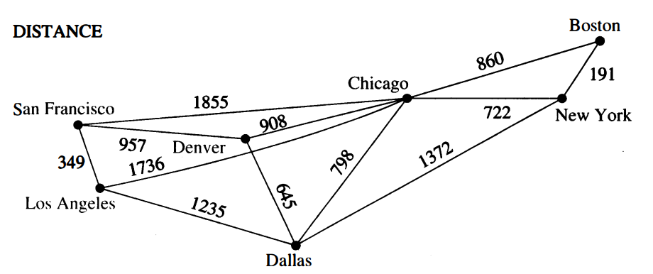
Shortest-Path Problem
There are several different algorithms that find a shortest path between two vertices in a weighted graph.
Weighted Graph: Graphs that have a number assigned to each edge are called weighted graphs.
Weighted graphs are used to model computer networks.

Slide 16
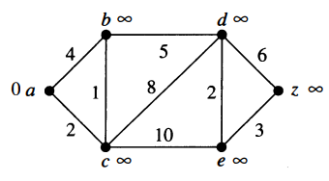
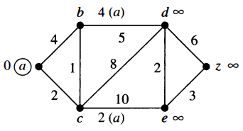
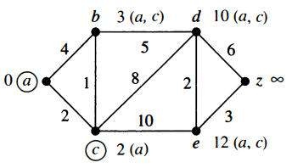
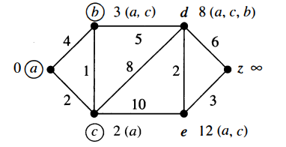
Example
What is the length of a shortest path from a to z in the following weighted graph? (Dijkstra’s Algorithm)

Slide 17
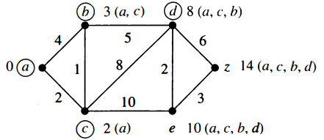
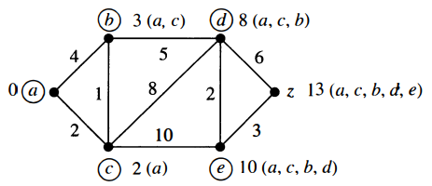
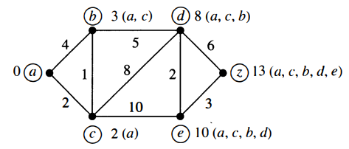
Example
What is the length of a shortest path from a to z in the following weighted graph?

Slide 18
Planar Graphs
A graph is called planar if it can be drawn in the plane without any edges crossing (where a crossing of edges is the intersection of the lines or arcs representing them at a point other than their common endpoints). Such a drawing is called a planar representation of the graph.
A graph may be planar even if it is usually drawn with crossings, because it may be possible to draw it in a different way without crossings.

Slide 19
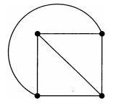
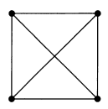
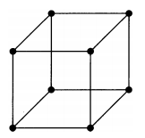
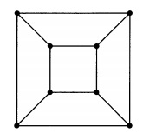
Example
Is K₄ planar?
Is Q₃ planar?

Slide 20
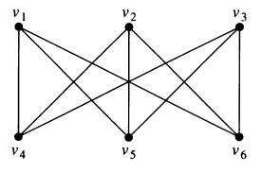
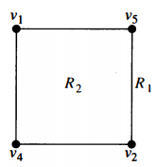
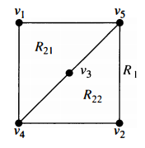
Example
Is K_{3,3} planar?
When v₃ is in region R₂, the edges between v₃ and v₄ and between v₃ and v₅ separate R₂ into two regions R₂₁ and R₂₂.
Now there is no way to place the final vertex v₆.

Slide 21

Euler’s Formula
Let G be a connected planar simple graph with e edges and v vertices. Let r be the number of regions in a planar representation of G. Then r = e – v + 2.
Proof: By induction;
Basis case: The relationship r₁ = e₁ – v₁ + 2 is true, where e₁ = 1, v₁ = 2, r₁ = 1
Assume that r_{n} = e_{n} – v_{n} + 2. We add the edge {a_{n+1}, b_{n+1}} to obtain G_{n+1} from G_{n}.

Slide 22
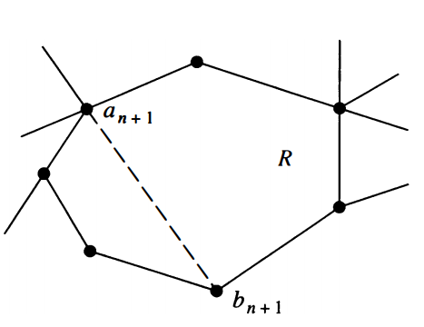
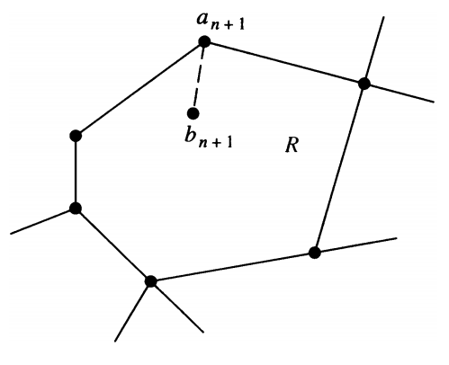
Euler’s Formula
Two cases:
a_{n+1} and b_{n+1} are already in G_{n}
r_{n+1} = r_{n} + 1, e_{n+1} = e_{n} + 1,
v_{n+1} = v_{n}.
r_{n+1} = e_{n+1} – v_{n+1} + 2.
b_{n+1} is added to G_{n}
r_{n+1} = r_{n} , e_{n+1} = e_{n} + 1,
v_{n+1} = v_{n} + 1.
r_{n+1} = e_{n+1} – v_{n+1} + 2.

Slide 23
Corollary 1
If G is connected planar simple graph with e edges and v vertices, where v ≥ 3, then e ≤ 3v -6.
Example 5: Show that K₅ is nonplanar using corollary 1.

